Slide 1
PractIcal Systems ThInkIng SwItchIng and combInIng MethodologIes developIng Your Systems skIlls
İsmet Özgür Çolpankan

Slide 2
OUTLINE
A. Switching and Combining Methodologies
Introduction
Assessing the systems task
Selecting methodology
Switching methodologies
B. Developing Your Systems Skills
Introduction
Systems thinking in your work
Case Studies

Slide 3
SWITCHING AND COMBINING METHODOLOGIES LEARNING OBJECTIVES
Examine situations which might require application of more than one system methodologies
Identify typical stages in a systems study when switching of methodologies might be appropriate
Suggest techniques which assist in switching and combining system methodologies within a single study

Slide 4
SWITCHING AND COMBINING METHODOLOGIES INTRODUCTION
So far, the use of system methodologies was described as if problems and situations present themselves in such a way that the choice of methodology is clear and obvious.
Conflict and unease are present.
Soft Systems Methodology
The presenting problem is structured and there is a large measure of agreement about it.
Hard Systems Methodology
Unfortunately, the analyst is rarely faced with situations where the choice of methodology is clear-cut.

Slide 5
SWITCHING AND COMBINING METHODOLOGIES INTRODUCTION
Where the choice is unclear or ambiguous, how should the analyst proceed?
Is it possible to apply more than one methodology during a single study?
How would you know which methodology to use first?
Can the analyst safely switch between methodologies in the middle of a study?
Those questions will be addressed.

Slide 6
SWITCHING AND COMBINING METHODOLOGIES INTRODUCTION
Switching and combining methodologies
Assessing the systems task
Selecting methodology
Switching methodologies

Slide 7
SWITCHING AND COMBINING METHODOLOGIES 1. ASSESING THE SYSTEM TASK
The analyst will be concerned not only with world-views in the problem setting but also with his or her own world-view.
The analyst’s approach to perceived problems and to applying systems methodologies will be influenced with his/her own world-view.
Different analysts will approach the same situation with different angle and different biases.

Slide 8
SWITCHING AND COMBINING METHODOLOGIES 1. ASSESING THE SYSTEM TASK (Cont’d.)
In deciding which methodology to use,
There is no requirement to choose.
Individuals tend to favor one methodology rather than another.
The analyst’s own inclinations and initial assessment of the situation are likely to swing his or her decision towards one of the three methodologies.
Intuitive hunches like this are often no worse than lengthy pondering, and have an advantage in that something of value will almost certainly be learned from a quick run through with any methodology.
However, there are some guideline which can help to improve efficiency.

Slide 9
SWITCHING AND COMBINING METHODOLOGIES 2. SELECTING THE METHODOLOGY
Many of the examples and case studies in both the “hard” and “soft” systems categories frequently have also a “failures” character.
Interventions in natural systems and in socio-technical systems often produce counter-intuitive outcomes (=failures).
If any doubt when starting a systems study little will be lost by using the FAILURES methodology first.
A lot can be learned even if there are apparently no significant failures.
The analyst can then decide which, if either or both of the HARD SYSTEMS or SOFT SYSTEMS Methodologies will be applied/followed-up next.

Slide 10
SWITCHING AND COMBINING METHODOLOGIES 2. SELECTING THE METHODOLOGY (Cont’d.)
If there is a large measure of agreement about the nature of the problem (or opportunity) and what is to be achieved,
HARD SYSTEMS Methodology could be applied from the start.
If the agreement is low or patchy,
SOFT SYSTEMS Methodology might be a better starting point.

Slide 11
SWITCHING AND COMBINING METHODOLOGIES 3. SWITCHING METHODOLOGIES
Typically a sensible switching point would be in the early stages of the HARD SYSTEMS Methodology or SOFT SYSTEMS Methodology when sufficient description and analysis has been done to indicate that another methodology would be better.
If the analyst starts the HARD SYSTEMS Methodology and discovers at systems description stage that FAILURES are manifest,
Find out more about the system so that counter-intuitive outcomes may be avoided; switch to Systems Failures methodology.
Similarly, if it is impossible in the use of HARD SYSTEMS Methodology clearly to identify objectives and constraints,
The analyst seems to not know enough about the systemic setting; switch to Failures methodology to gain understanding.
If uncertainties and differences of opinion arise about objectives; switch to SSM.

Slide 12
SWITCHING AND COMBINING METHODOLOGIES 3. SWITCHING METHODOLOGIES (Cont’d.)
If starting with SSM, the rich picture analysis may throw up apparently significant failures.
Switch SYSTEMS FAILURES methodology to gain greater understanding of the problem situation before returning to SSM.
Having identified relevant systems there may be a large measure of agreement about them; switch to HARD systems methodology.
After the debate stage of SSM, it is often useful to to use a Hard systems approach in order translate the “whats” of the conceptual models agreed upon into “hows”.

Slide 13
SWITCHING AND COMBINING METHODOLOGIES SUMMARY
Selecting, combining and switching systems methodologies is something of an art.
There are no rights or wrongs about it but analysts who learn to do it skillfully tend to achieve more effective results than do those who simply resort out of habit to the one methodology they know best.
If in doubt, use SYSTEMS FAILURES methodology to start.
Applying different methodologies in series can be very fruitful but sometimes you may have to switch methodologies in mid-stream.
This can be done safely if the guidance above is followed.
If time is short, use systems ideas and only as much of the formal methodologies as you think justifiable to assist the system task.

Slide 14
DEVELOPING YOUR SYSTEMS THINKING INTRODUCTION
Applied systems requires a way of thinking rather than blind adherence to formulatic methods.
Requires a reflexive and adaptive mind which is capable of trying new methods and techniques and bending the rules when appropriate.

Slide 15
DEVELOPING YOUR SYSTEMS THINKING ASSUMPTIONS AND DEBATES
There are world-view clashes about world-views:
World-views about
the nature of the social world;
the neutrality of humans in what they perceive, interpret, consider important and how they respond;
the nature of the organizations;
the individual and group behavior such as attitudes, motivation, culture, power, learning;
the systems ideas.
A competent systems thinker is aware of such complex factors.

Slide 16
DEVELOPING YOUR SYSTEMS THINKING OTHER SYSTEMS METHODOLOGIES AND TECHNOLOGIES
In addition to the 3 methodologies covered, there are other methodologies:
Viable Systems Methodology (VSM)
Critical Systems Thinking (CST)
Total Systems Thinking (TSI)
Viable Systems Methodology (VSM):
Based on cybernetic model of organization (ideas about intelligent machines).
VSM model of organization includes recursion or nests of lower-order systems.
Has been used extensively as a conceptual tool for understanding organizations, redesigning them and supporting the change management.

Slide 17
DEVELOPING YOUR SYSTEMS THINKING OTHER SYSTEMS METHODOLOGIES AND TECHNOLOGIES
Critical Systems Thinking (CST):
Seeks to combine aspects of functionalism and interpretism with radical humanism.
The analyst is required to make explicit her world-view in developing a constructive criticism of a particular system.
Total Systems Thinking (TSI):
A derivative of CST, seeks to encourage creative thinking about organizations and their problems.
Advocates the interactive combination of three components: system metaphors, a system of systems methodologies, individual methodologies.

Slide 18
DEVELOPING YOUR SYSTEMS THINKING SELF CONFIDENCE
One sign of developed skills in practical systems thinking is the self-confidence to make the methodologies and techniques your own.
Systems work should not be about slavishly and blindly following orthodox rules thought up by someone else.

Slide 19
SYSTEMS THINKING IN YOUR WORK SOFT SYSTEMS METHODOLOGY
Soft systems thinking seeks to explore the ‘messy’ problematic situations that arise in human activity.
Soft systems strive to learn from the different perceptions that exist in the minds of the different people involved in the situation (Andrews, 2000).
Checkland (1999), and Checkland and Scholes (1990) have attempted to transform these ideas from systems theory into a practical methodology that is called Soft Systems Methodology (SSM).
SSM attempts to understand the wicked and fuzzy world of complex organisations (Checkland, 1999, p. 258).

Slide 20
SYSTEMS THINKING IN YOUR WORK SOFT SYSTEMS METHODOLOGY

Slide 21
CASE STUDY: APPLICATION OF SSM TO KNOWLEDGE MANAGEMENT ABSTRACT
Construction projects are faced with a challenge that must not be underestimated.
Are increasingly becoming highly competitive, more complex, and difficult to manage.
Difficult to solve using traditional approaches.
Soft Systems Methodology (SSM) is a systems approach that is used for analysis and problem solving in such complex and messy situations.
SSM uses “systems thinking” in a cycle of action research, learning and reflection to help understand the various perceptions.

Slide 22

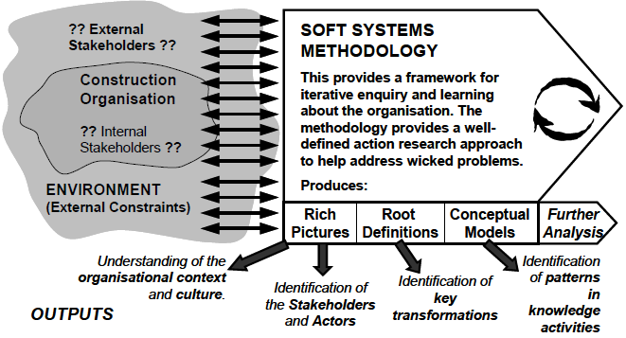
CASE STUDY: APPLICATION OF SSM TO KNOWLEDGE MANAGEMENT ABSTRACT
INTRODUCTION

Slide 23
CASE STUDY: APPLICATION OF SSM TO KNOWLEDGE MANAGEMENT CASE 1: PRE-TENDERING
INTRODUCTION
A major Australian construction contractor company was chosen for the study.
A less formal, rather complex and poorly defined organizational process, pre-tendering process, was chosen.
Pre-tendering is the process by which this organisation makes an early decision to continue, or not, further venturing in a specific project.
It is a process that is embedded in the organization routine and knowledge for carrying out this process mostly resides in the heads of the people in a tacit form.
Therefore, pre-tendering presents a good example for illustrating knowledge management implications that are basically concerned with the capture/elicitation, codify, transfer and sharing of embedded, tacit knowledge.

Slide 24
CASE STUDY: APPLICATION OF SSM TO KNOWLEDGE MANAGEMENT CASE 1: PRE-TENDERING
STEP-1: INFORMATION ABOUT PROBLEM SITUATIONS
In the pre-tendering process, if an individual team member were to leave the organisation, the loss of tacit knowledge could seriously impact the efficiency of the process.
In such circumstances it becomes necessary to make the knowledge involved in the process explicit.
Difficulty can arise when attempting to capture related knowledge through a simple flow chart or other illustrating techniques.
A flow chart cannot capture the context and does not provide insight into a system that contains interdependent human and technological components.
Soft System Methodology serves as an important tool for knowledge elicitation in such circumstances as it aims at understanding the context in which the whole system functions.

Slide 25
CASE STUDY: APPLICATION OF SSM TO KNOWLEDGE MANAGEMENT CASE 1: PRE-TENDERING
STEP-2: RICH PICTURE
Interviews with selected project team members were conducted to develop a rich picture
Developing the rich picture is an iterative process, two iterations were carried out .
In first iteration, interviews were asked informal, unstructured questions about their involvement in the pre-tendering process based upon their experience and expectations
After the interviews, notes taken during the interview were utilized to develop a rich picture.

Slide 26
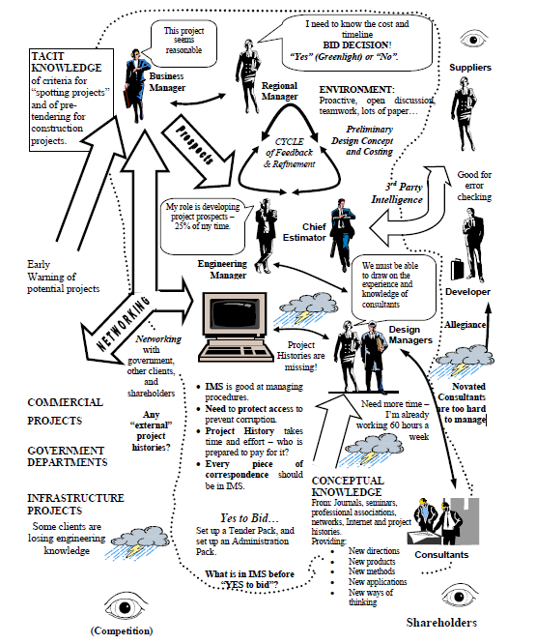
CASE STUDY: APPLICATION OF SSM TO KNOWLEDGE MANAGEMENT CASE 1: PRE-TENDERING
STEP-2: RICH PICTURE
The rich picture portrayed all the key players involved in the process and presented a structured view by putting into context the factors affecting the process.

Slide 28
CASE STUDY: APPLICATION OF SSM TO KNOWLEDGE MANAGEMENT CASE 1: PRE-TENDERING
STEP-3: ROOT DEFINITION
A system owned by the pre-contracts team, who together with the Chief Estimator and the Design Managers, takes prospective projects from the Business Manager, together with knowledge, processes and technology, and prepares preliminary understanding of the project and cost estimates.
This is used to assist the Regional Manager in assessing the feasibility of making a tender bid. This must be undertaken within short timeframes and with expert assistance from consultants. This is taking place in a very competitive environment where the “fit” to our business objectives and corporate goals, cost and the timeline are all important.

Slide 29
CASE STUDY: APPLICATION OF SSM TO KNOWLEDGE MANAGEMENT CASE 1: PRE-TENDERING
STEP-4: CATWOE
Customer: Regional Manager (RM)
Actors: Engineering Manager, Chief Estimator, Design Manager, Pre-Contracts team, Business Manager.
Transformation: Knowledge, processes and technology together with details of prospective projects, are used to prepare an understanding of the project and a cost estimate for assessing the feasibility of a tender bid.
Weltanschauung: To assess the feasibility of making a tender bid, we (RM) need a good understanding of the project – does it fit our corporate objectives - and cost and timeline details.
Owner: Pre-Contracts Team
Environment: Competitive, quality, cost and time critical, community and corporate goals.

Slide 30
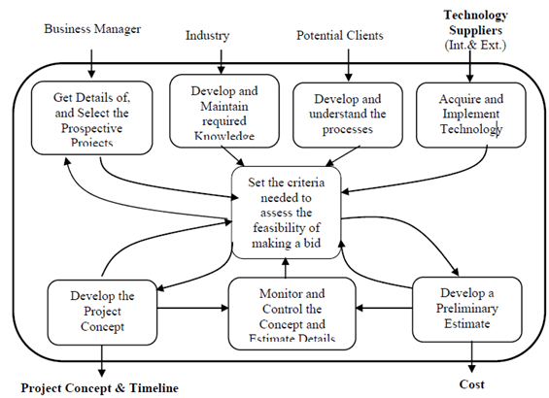
CASE STUDY: APPLICATION OF SSM TO KNOWLEDGE MANAGEMENT CASE 1: PRE-TENDERING
STEP-5: CONCEPTUAL MODEL

Slide 31
CASE STUDY: APPLICATION OF SSM TO KNOWLEDGE MANAGEMENT CASE 1: PRE-TENDERING
LAST THREE SSM STAGES
The initial version of rich picture and model were presented to a focus group of the pre-tendering team members.
Participants of focus group, seeing themselves in a picture and interacting with each other were able to elicit further knowledge.
This facilitated the refinement of the rich picture and conceptual model, and some of the confusion and misunderstanding that resulted from the initial interviews was resolved.
With this enhanced understanding, especially of tacit knowledge, the researchers prepared the second iteration of the rich picture and conceptual model.

Slide 32
CASE STUDY: APPLICATION OF SSM TO KNOWLEDGE MANAGEMENT CASE 1: PRE-TENDERING
LAST THREE SSM STAGES
Next step is to follow-up with the team members with more structured questions emerging out of the activities identified in the conceptual model.
Forms the basis of comparison between the reality of the real world pre-tendering, and the “ideal” expressed by the conceptual model.
Provides the framework to focus on the issues and opportunities, examine assumptions, and better understand the dysfunctional behaviours/actions that need to be remedied.
Provides a reality check for the analysis to date.
Is the point where SSM initiates a process to rethink and re-analyse the underlying assumptions in order to identify the desirable and feasible options for change and improvement in the pretendering process.

Slide 33
CASE STUDY: APPLICATION OF SSM TO KNOWLEDGE MANAGEMENT CASE 1: PRE-TENDERING
CONCLUSION
The complete utilisation of SSM would formalise the knowledge of the pre-tendering process in explicit formwithout loosing the context, highlight problematic areas and provide recommendations to improve the process.

Slide 34

CASE STUDY: APPLICATION OF SSM TO KNOWLEDGE MANAGEMENT CASE 2: PROJECT HISTORIES
STEP-1: INFORMATION ABOUT PROBLEM SITUATIONS
In the same organization with Pre-tendering case study.
Pre-tendering team places a very high value on the use of Project Histories so as to prepare a realistic preliminary estimate and concept of the project for which pre-tendering process is being carried out.
The research team is of the opinion that it is worthwhile to further investigate the issues barring the effective utilisation of the Project Histories.
The same approach in previous case study was adopted to develop the Rich Picture, Root Definition and Conceptual Model.

Slide 35
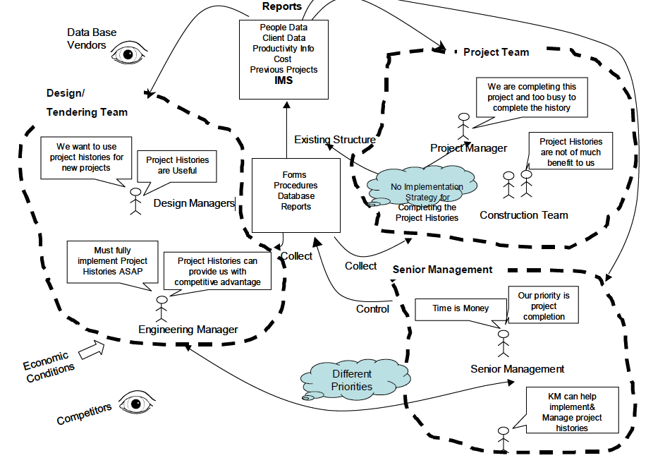
CASE STUDY: APPLICATION OF SSM TO KNOWLEDGE MANAGEMENT CASE 2: PROJECT HISTORIES
STEP-2: RICH PICTURE

Slide 36
CASE STUDY: APPLICATION OF SSM TO KNOWLEDGE MANAGEMENT CASE 2: PROJECT HISTORIES
STEP-3: ROOT DEFINITIONS
A system owned by the Engineering Manager, who together with the Design Managers, seek data, information and knowledge from previous projects stored in Project histories in order to prepare realistic preliminary understanding of the project and cost estimates for pre-tendering process and then for preparing the project bids.

Slide 37
CASE STUDY: APPLICATION OF SSM TO KNOWLEDGE MANAGEMENT CASE 2: PROJECT HISTORIES
STEP-4: CATWOE
Customer: Senior Management, Future Design Managers, Project Managers
Actors: Engineering Manager, Design Managers, Project Managers, Construction Team
Transformation: Knowledge, processes and technology together with details of past projects, are used to create and maintain a repository of a Project histories that can be used when preparing a tender bid for a new project.
Weltanschauung: To assess the feasibility of making a tender bid, a good understanding of the project is required based upon previous organization experience and knowledge.
Owner: Engineering Manager
Environment: Competitive, Quality, Cost and time critical, Community and Corporate Goals.

Slide 38
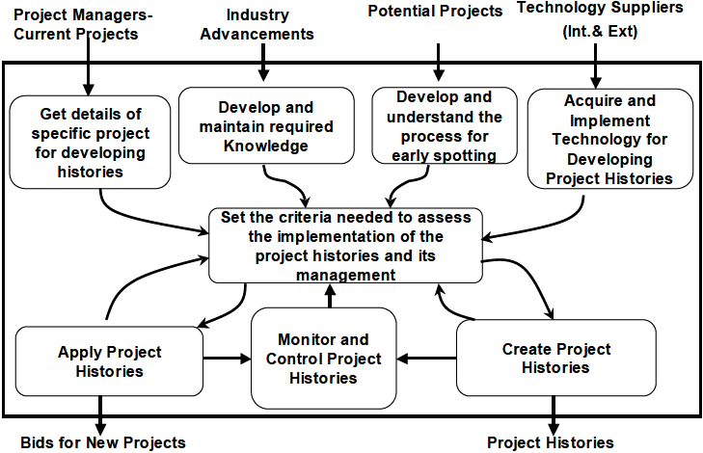
CASE STUDY: APPLICATION OF SSM TO KNOWLEDGE MANAGEMENT CASE 2: PROJECT HISTORIES
STEP-5: CONCEPTUAL MODEL

Slide 39
CASE STUDY: APPLICATION OF SSM TO KNOWLEDGE MANAGEMENT CASE 2: PROJECT HISTORIES
KNOWLEDGE ELICITED ABOUT PROJECT HISTORIES
Project Histories: basically the repositories/data bases that are developed to contain useful information and knowledge from the previous projects.
The information, like productivity rates on previous projects, cost and timelines, and client details, mainly form the part of these repositories.
Developing a history requires the sifting through of huge volumes of information generated while project is being executed, and identifying and sorting the information that may be of use on next projects.
Most of the knowledge carried from one project to other remains “Tacit” – residing as knowledge of individuals.

Slide 40
CASE STUDY: APPLICATION OF SSM TO KNOWLEDGE MANAGEMENT CASE 2: PROJECT HISTORIES
CONCLUSION
Knowledge Management places a great emphasis upon the project histories.
Efforts are made to turn “Tacit” knowledge of the individuals into “Explicit” and is disseminated to all others through these repositories (see Conceptual Model).
These repositories, then, contain lessons learnt, unique problem handling techniques devised by the individual when faced with problem on the project, etc so as to stop “Re-inventing the wheel” on the next project thus saving time and resources.
Attaching the context of Knowledge Management to the scenario of project histories will give these histories a new vigour and framework for understanding by both senior management and the project team.

Slide 41
THE END…

Slide 42
REFERENCES
Waring, A. (1996). Practical system thinking.
Maqsood, T., Finegan, A. D., Walker, D. H. T. Five case studies applying soft systems methodology to knowledge management.

